Slide 1
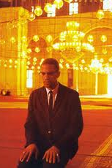
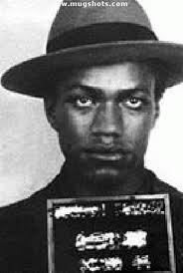
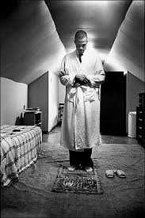
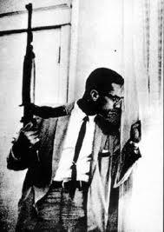
Out the Box:
Malcolm X

Slide 2
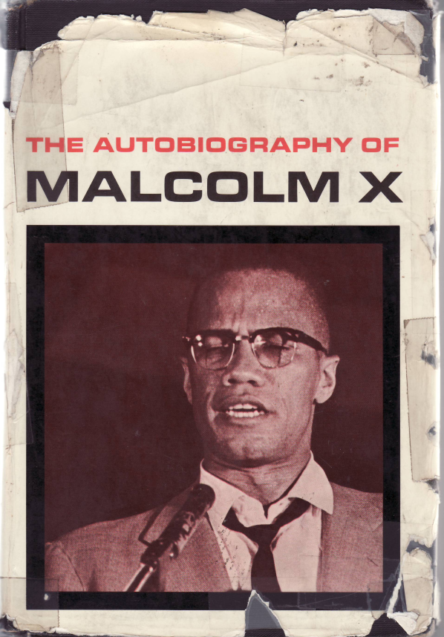
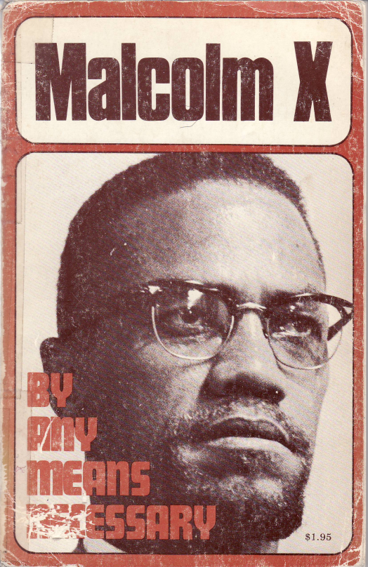
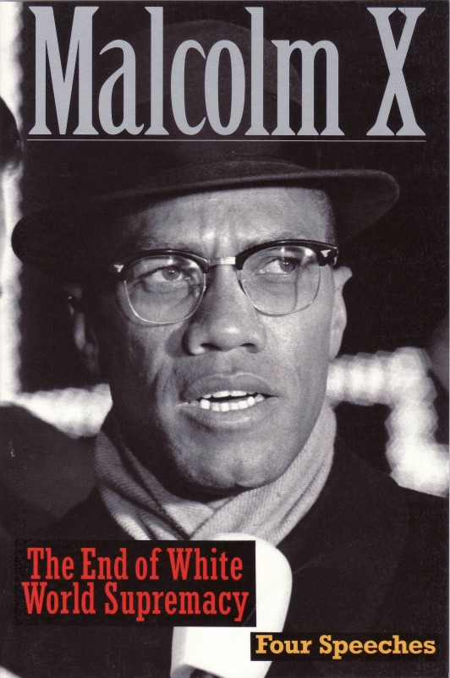
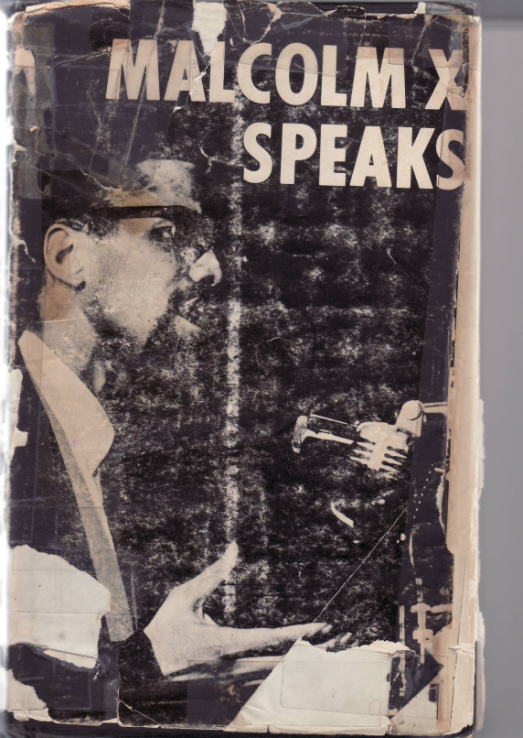
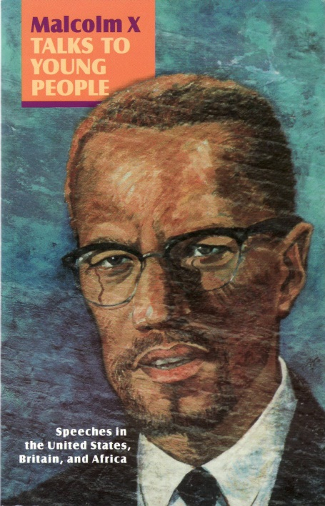
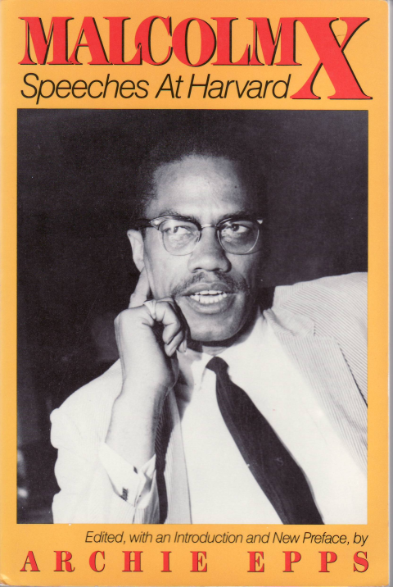
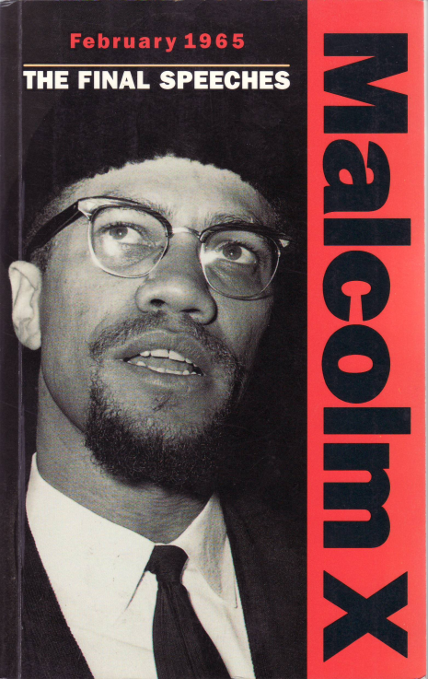
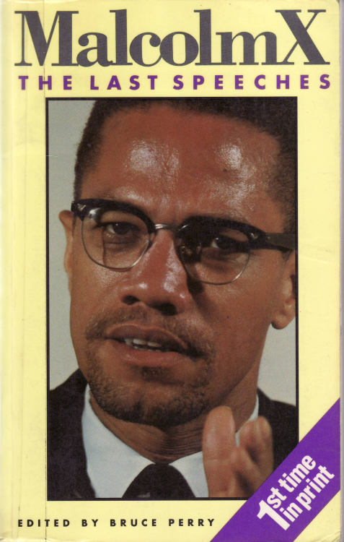

Slide 3
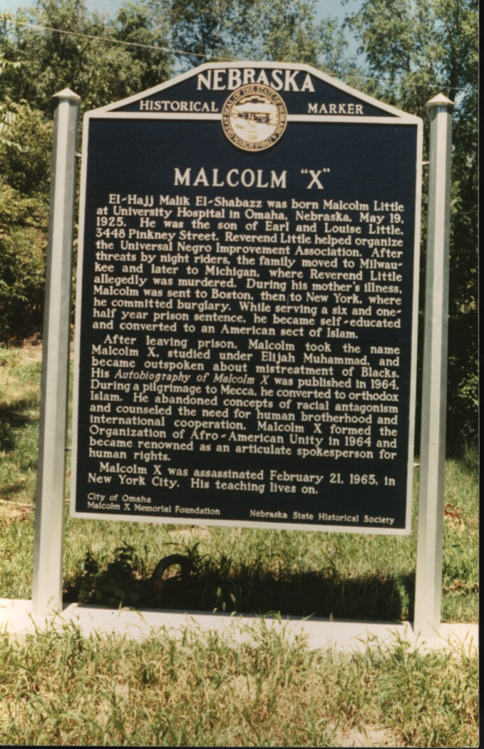
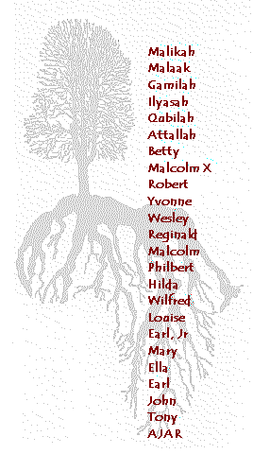
Lessons from the life of Malcolm X

Slide 4
Little Family legacy of Ideological Traditions
Ideological tradition | Family Legacy
PanAfricanism | Mother was born in Grenada, and both parents in the UNIA
Nationalism | Father a major community organizer for the UNIA
Black liberation theology | Father a Baptist minister and mother a devout Seventh Day Adventist
Feminism/womanism | Strong mother, sisters and half-sister
Socialism | Father taught and practiced self reliance and self-determination, including building ones own house and having a garden for food

Slide 5
How the Stages of Malcolm X’s Life
maps the general Black Experience
Name | Space | Institution | Crisis | General type
Malcolm Little | Small mid-western towns, small Black community | Family and school | Racism in school, murder of father, hospitalization of mother | Positive youth experiences
Detroit Red | Large East coast cities, large Black populations | The “street” and prison | Drugs, violence, and arrest | Negative youth experiences
Malcolm X | National minister, travels nationally | Nation of Islam | Contradiction in the NOI | Born again religious convert , nationalist political activist
Omowale | Global activist in Africa, Middle East and Europe | OAAU and MMI | Conflicts with the NOI and global security forces | Revolutionary political activist and Sunni minister

Slide 6
Methodological approach of Malcolm X:
Principles for Black Students
Think for yourself: “Its good to keep wide open ears and listen
to what everybody has to say…you have to
weigh all of what you’ve heard…(but) come
to a decision for yourself and you’ll never
regret it.”
2. Practice self-criticism: “My greatest lack has been, I believe, that I don’t
have the kind of education I wish I had been
able to get…”
3. Master language “I love languages. I wish I were an accomplished
linguist.” (Read the dictionary.)
4. Study history: “Of all our studies, history is best qualified to
reward our research”
5. Learn to debate: “…in the prison, debating, speaking to a crowd, was as exhilarating to me as the discovery of knowledge through reading had been.”

Slide 7
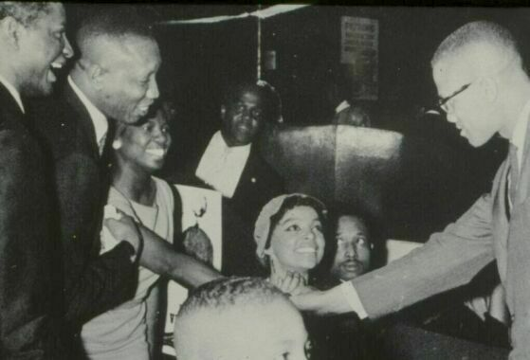
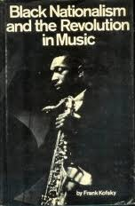
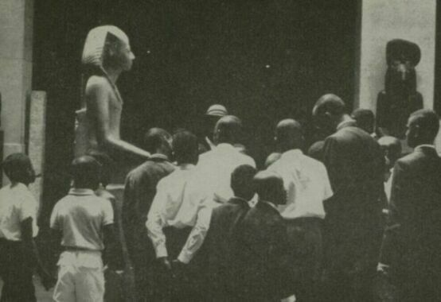
Black cultural creativity is key to survival

Slide 8
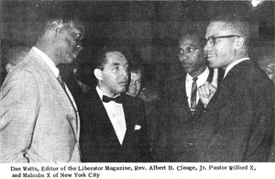
Black ideological and political radicalism was a
collective process with Malcolm X as its major voice
(Nov. 1963, just before “Message to the Grassroots” speech)

Slide 9
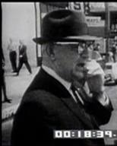
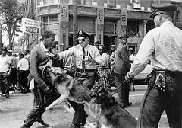
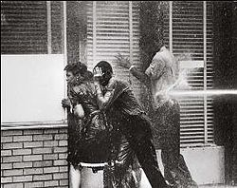
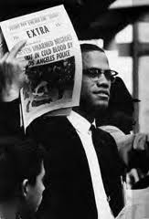
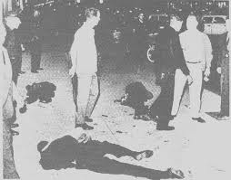
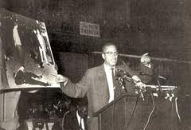
The movement context for the
Detroit speeches of Malcolm X
1963
Battle of
Birmingham
1962
Murder of
Ronald Stokes

Slide 10
The curriculum encoded in
the speeches of Malcolm X

Slide 11
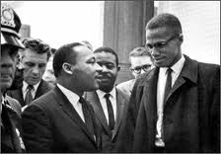
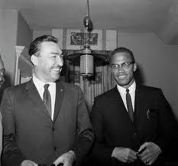
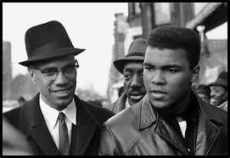
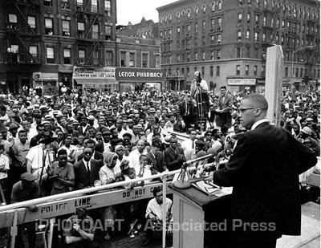
Lesson 1:
Unity is the foundation for our struggle
What you and I need to do is learn to forget our differences. When we come together, we don't come together as Baptists or Methodists. You don't catch hell 'cause you're a Baptist, and you don't catch hell 'cause you're a Methodist. You don't catch hell 'cause you're a Methodist or Baptist. You don't catch hell because you're a Democrat or a Republican. You don't catch hell because you're a Mason or an Elk. And you sure don't catch hell 'cause you're an American; 'cause if you was an American, you wouldn't catch no hell. You catch hell 'cause you're a black man. You catch hell, all of us catch hell, for the same reason.

Slide 12
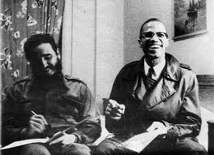
Lesson 2:
Our strategic focus
is revolution
The white man knows what a revolution is. He knows that the black revolution is world-wide in scope and in nature. The black revolution is sweeping Asia, sweeping Africa, is rearing its head in Latin America. The Cuban Revolution -- that's a revolution. They overturned the system. Revolution is in Asia. Revolution is in Africa. And the white man is screaming because he sees revolution in Latin America. How do you think he'll react to you when you learn what a real revolution is? You don't know what a revolution is. If you did, you wouldn't use that word.
A revolution is bloody. Revolution is hostile. Revolution knows no compromise. Revolution overturns and destroys everything that gets in its way. And you, sitting around here like a knot on the wall, saying, "I'm going to love these folks no matter how much they hate me." No, you need a revolution. Whoever heard of a revolution where they lock arms, as Reverend Cleage was pointing out beautifully, singing "We Shall Overcome"? Just tell me. You don't do that in a revolution. You don't do any singing; you're too busy swinging. It's based on land. A revolutionary wants land so he can set up his own nation, an independent nation. These Negroes aren't asking for no nation. They're trying to crawl back on the plantation.

Slide 13
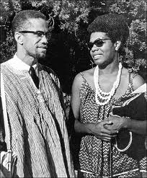
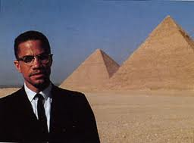
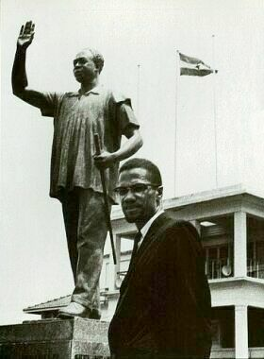
Lesson 3:
Africa
the key to global revolution
Malcolm taught us to reconnect with our African identity

Slide 14
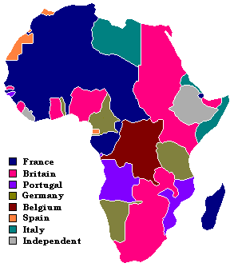
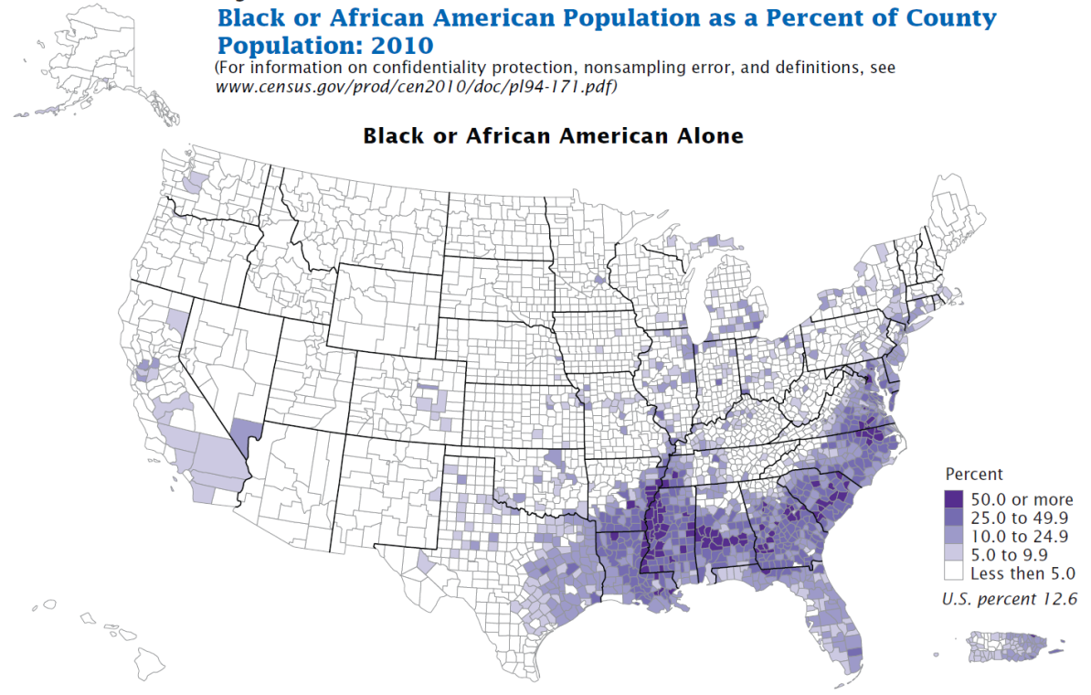
Lesson 4:
Land
Political economy is a
required subject to study
European land grab in Africa during
the Berlin conference of 1884-85
1% vs 99%
Production forces: land, labor and capital
Production relations: Who works? Who owns?

Slide 15
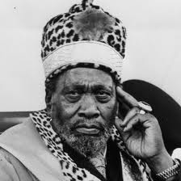
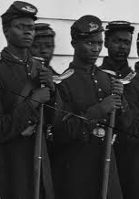
Lesson 5:
History is key to our study,
the history of revolution
Bloodshed
1. American Revolution 1776 - capitalism
2. French Revolution 1789 - capitalism
3. Russian Revolution 1917 - socialism
4. Chinese Revolution 1949 - socialism
5. Cuban Revolution 1959 - socialism
6. Algerian Revolution 1962 - national liberation
7. Kenyan Revolution 1963 - national liberation

Slide 16
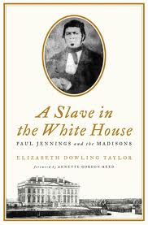
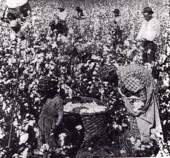
Lesson 6:
Class analysis is essential
to tell friends from enemies
“There were two kinds of slaves. There was the house Negro and the field Negro.”

Slide 17
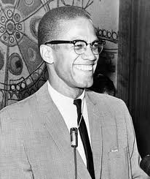
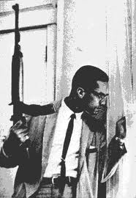
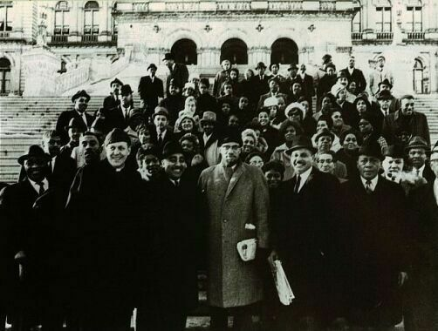
Lesson 7:
Strategy/tactics
Ballots and Bullets
The political philosophy of black nationalism means that the black man should control the politics and the politicians in his own community; no more. The black man in the black community has to be re-educated into the science of politics so he will know what politics is supposed to bring him in return. Don't be throwing out any ballots. A ballot is like a bullet. You don't throw your ballots until you see a target, and if that target is not within your reach, keep your ballot in your pocket.
Malcolm X meeting with politicians in NY state capitol.

Slide 18
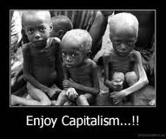
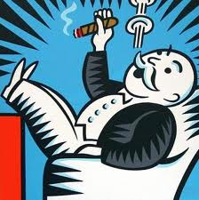
Lesson 8:
Capitalism is not a viable system.
It is impossible for capitalism to survive, primarily because the system of capitalism needs some blood to suck. Capitalism used to be a like the eagle, but now it is more like a vulture…As the nations of the world free themselves. Then capitalism has less victims, less to suck, and it becomes weaker and weaker. It is only a matter of time in my opinion before it will collapse completely.

Slide 19
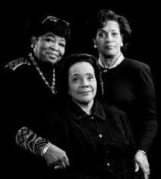
Lesson 9:
Women must be have full equality!
One thing I noticed in both the Middle East and Africa, in every country that was progressive, the women were progressive. In every country that was underdeveloped and backward, it was the same degree that the women were underdeveloped, or undeveloped and backward.
Betty Shabazz, Coretta Scott King, Myrlie Evers

Slide 20
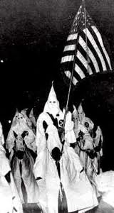
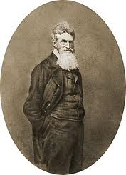
Lesson 10:
White people need to straighten up
I’m not a racist. I don’t judge a man because of his color. I get suspicious of a lot of them (Whites) and cautious around a lot of them – from experience. Not because of their color, but because of what experience has taught me concerning their overall behavior toward us…We are against them because of what they do to us and because of what they do to others. All they have to do to get our good will is to show their good will and stop doing all those dirty things to our people.
John Brown

Slide 21
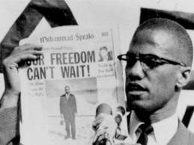
Legacy of the lessons Malcolm X taught
Assassination of Malcolm X (1965)
Black Panther Party (1966)
Black power Conference in Newark (1967)
*1st Black Studies Program at San Francisco State (1968)
Olympics Black Power salute (1968)
*The Black Scholar (1969)
The League of Revolutionary Black Workers (1969)
Malcolm X Liberation University (1969)
*The Journal of Black Studies (1970)
Congress of African People (1970)
Black Political Assembly (1972)
Council of Independent Black Institutions (1972)
African Liberation Support Committee (1972)
6th Pan African Congress (1974)

Slide 22
So, why Malcolm X?
Icon
Paradigm
Agency

